Slide 1


CREDIT CARD TRANSACTIONS ANALYSIS
POWERBI PROJECT PRESENTATION
By
AKASH NARANG

Slide 2
PROBLEM STATEMENT
Objective
  XYZ Bank is a legacy financial institution headquartered in Mumbai. They want to introduce a new line of credit cards, aiming to broaden their product offerings and reach in the financial market.
Task
  To analyse the provided sample data and report key findings to the strategy team of XYZ Bank. This analysis is expected to guide them in tailoring the credit cards to customer needs and market trends.

Slide 3
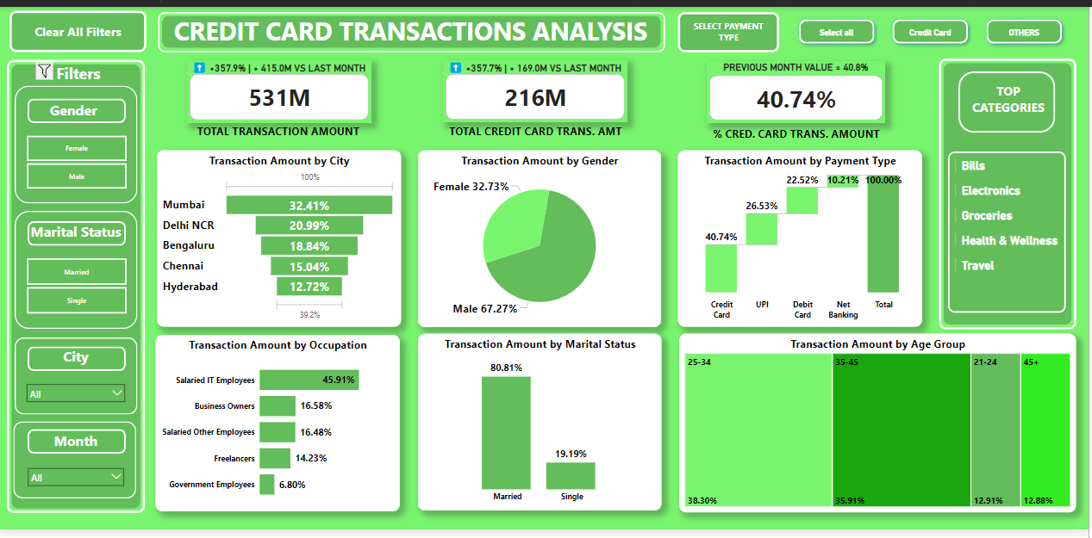
POWER BI REPORT

Slide 4
INSIGHTS
Mumbai accounted for 32% of total transactions by credit card followed by Delhi NCR(21%), Bengaluru(19%), Chennai(15%), Hyderabad(13%).
Males accounted for 67% of the total transactions by credit card and females accounted for 33%.
The top-most category for which females use credit card is Apparels.
The top-most category for which males use credit card is Bills Payment.
Out of total transactions, 40.74% were through credit card.
Salaried IT employees accounted for 46% of the transactions by amount followed by Business Owners(17%), Other Salaried Employees(16%), Freelancers(14%), Government Employees(7%).
Married People were responsible for 81% of the total transactions by amount and single people accounted for 19% of the total transactions.
Age Group 25-34 was responsible for 38% of the total transactions by credit card followed by age groups 35-45(36%), 21-24(13%), 45+(13%).
The top three categories for which married people use credit cards are Bills, Electronics and Groceries.
The top three categories for which single people use credit cards are Bills, Electronics and Entertainment.

Slide 5
RECOMMENDATIONS
The new line of credit cards can be introduced in 3 phases based on insights generated.
Persons living in Mumbai, are salaried IT employees, are married and are in the age group 25-34 and 35-45 should be primary target in the first phase. This segment of customers is already using credit cards. So no awareness is required to be generated for this segment. These should be primary target for starters. Once this is done, Salaried IT employees in other cities like Delhi NCR, Bengaluru, Chennai, Hyderabad should be next target. Campaigns should be carried out to reach out to these customers.
Once we have established our credit card business in above 5 cities by targeting salaried IT employees in the age groups 25-34 and 35-45, our next course of actions can be to reach out to business owners, other salaried employees in the age group. This segment of customers is using credit cards but not very frequently. Targeted campaigns to reach out to this segment should be the focus in second phase.
In the third phase, freelancers and Government employees in the age groups 25-34 and 35-45 should be the next target. This segment of customers is not using credit cards. First –of- all awareness campaigns need to be carried out with this segment in primary focus. Cash backs can be introduced on day- to- day items such as groceries to lure this segment.
For the time being, we should not focus on age groups 21-24 and 45 + because this segment rarely use credit card and if they do, the transactions amounts are pretty low as compared to other two segments.

Slide 6
THANK YOU

